Slide 1


MIAD
Maestría
en Inteligencia Analítica de Datos

Slide 2



MIAD
Segmentación y Targeting
Caso: ESSEC Business School
Maestría
en Inteligencia Analítica de Datos
Sesión sincrónica
Ejercicio semana 3

Slide 3



At the time of this writing, ESSEC Business School is ranked #6 among European Business Schools (Financial Times). While one of its flagship programs is its Master In Management (#6 worldwide, FT ranking), the school has a significant executive education activity, mostly located on its La Défense campus (right on the outskirt of Paris).
Executive Education is typically split into two categories: customized programs and open-enrollment programs. ESSEC is ranked #3 worldwide for customized programs (i.e., programs designed specifically for a company and its employees) and #16 for open-enrollment programs (i.e., general programs targeting a wide audience of business executives).
Among the open-enrollment programs, one of the degrees delivered by ESSEC Business School is its Executive MBA. EMBA students are fairly senior in their fields and possess considerable work experience. Participants in an EMBA program typically hope to hone their leadership skills, accelerate their careers or change professional orientation.
The Management of ESSEC Business School Executive Education (EEE) wishes to improve the experience (and ranking) of the program and customize its content to the varying needs of the audience. To that avail, the program would offer several modules throughout the year in smaller groups, and interested participants would sign into the module(s) of their choice.

Slide 4
Of course, the design of customized modules requires a better understanding of why participants decided to join the ESSEC Executive MBA in the first place: their needs, desires, frustrations, and motivations. Management decided to survey current and past participants and ask them about their motivations for joining the program.
Segmentation questions (bases) Respondents were asked to rate on a 1-5 scale whether the following factors were important in their choices to join the ESSEC Executive MBA:
Discriminant variables (descriptors)
The survey included a few descriptors:
Gender Country Age Years of professional experience Financed by your company
Networking Reputation of the school Changing company Academic knowledge Cost-driven Location Ranking of the program Increasing your salary Launching your own company
Personal development Changing career Obtaining a promotion Benchmarking yourself Getting out of the office Broadening your horizon International perspective Improving English
Improving leadership skills

Slide 5
Question 1
Run a segmentation analysis and decide on an appropriate number of segments. Justify your choice. Remember that choosing the “right” number of segments is not always straightforward and depends on several factors, such as statistical criteria, managerial considerations, practical constraints, targetability of the segments, etc.
Tip: Try different segment solutions (e.g., 2, 3, 4, 5), and see which offers the best balance between segment homogeneity, segment distinctiveness, managerial usefulness, and targetability. Remember that, in the context of managerial decision making, statistical criteria are important, but not necessarily paramount.
Question 2
Create a “persona” for each segment. Each persona should contain at a minimum (1) A segment name; (2) A picture or pictorial representation; (3) A description (expectations, profiles, highlights, etc.). The description can be a story, a set of charts and summary figures, or (even better) a combination of both.

Slide 6
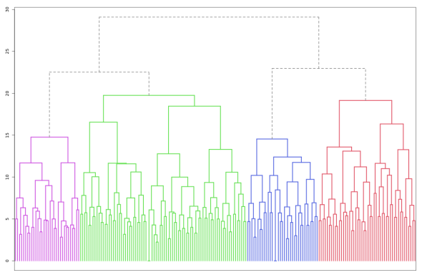
R. While there is no “perfect” answer to the first question (how many segments?), the best compromise seems to be four segments. Still, we recommend weighing the explanations behind the choice more than the choice itself.
Four segments
The four-segment solution reveals four groups with distinct needs and ambitions that we have tentatively named: the entrepreneurs, the thinkers, the sharks and the pivots
We describe each in turn below.
The thinkers
The sharks
The entrepreneurs
The pivots

Slide 7
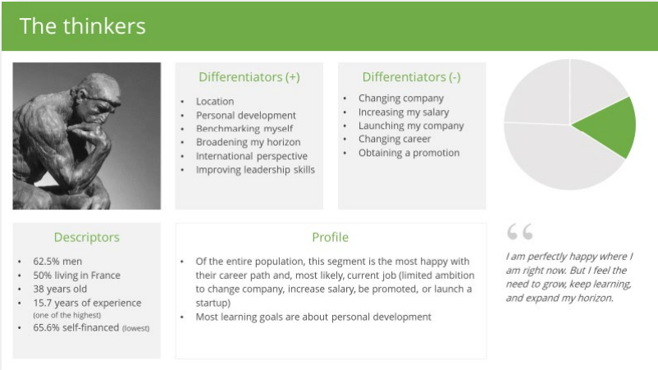
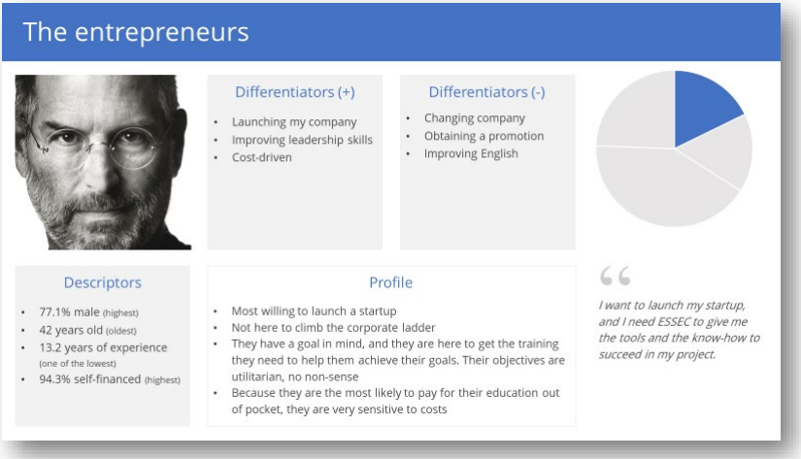

Slide 8
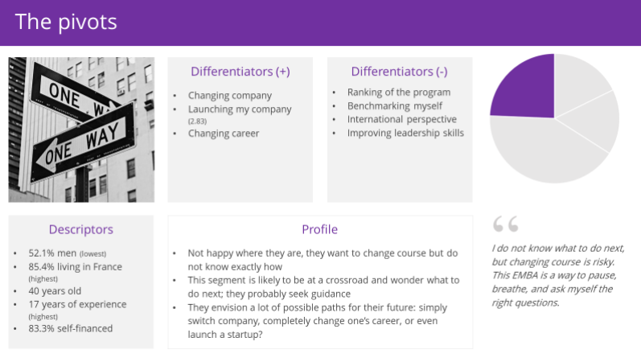
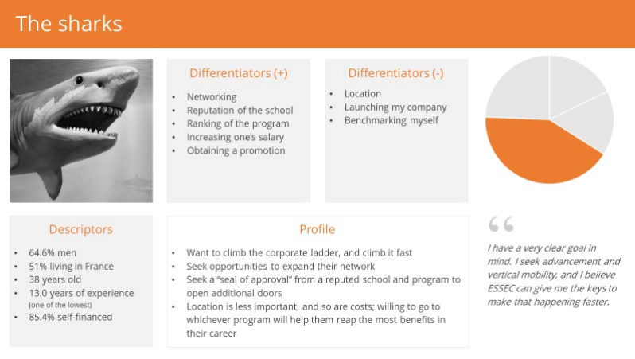

Slide 9
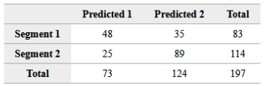

Two segments
A two-segment solution gives two balanced segments (83 and 114 respondents, respectively), which may be useful if the groups were to be separated into modules. The hit rate in the classification model (cf. confusion matrix) is underwhelming (70%), which suggests that the segments could barely be targeted based on their descriptors.
Confusion matrix (count). The model has correctlu classified 137 of the 197 observations. The off.diagonal elements are classification errors.
Confusion matrix (%). The global hit rate of the model is 70%. The diagonal elements represent segment-specific hit rates.

Slide 10
The biggest issue with a two-segment solution is that the two segments are not homogeneous enough, and their motivations (and needs) still vary greatly.
The “entrepreneurs” and the “pivots” are grouped together. While these two groups have the highest interest in launching their startup, their motivations vary greatly. The “pivots” may also decide to stay in a corporate career for the second half of their professional life but possibly in a different industry, whereas the “entrepreneurs” seem set on an entrepreneurial career.
With two segments, the “sharks” and the “thinkers” are also grouped in the same segment. While those segments are the least likely to “change their career,” their ambitions and goals appear quite different. Stopping at two segments may give the appearance of a homogeneous solution, but exploring more segments will make it clear it is not.

Slide 11
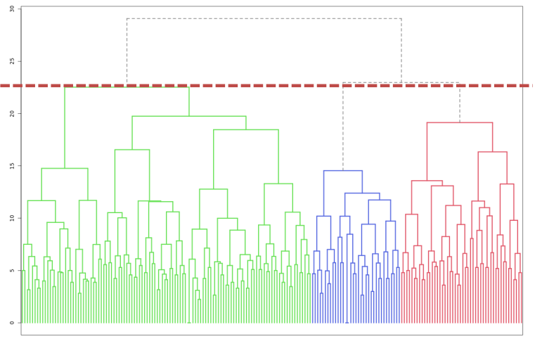
Three segments
With three segments, one of the above segments is divided into two subgroups and reveals the “entrepreneurs” and the “pivots.”
From a purely statistical point of view, however, the four-segment dendrogram reveals that about the same level of information is lost going from four-to-three as from three-to-two segments (the red dashed line below). In other words, if the information revealed by going from two to three segments is sufficient to justify the added complexity of having more segments, then it should equally justify going from three to four segments.
The thinkers + The sharks
The entrepreneurs
The pivots

Slide 12
Besides, a three-segment solution is imbalanced, with a very large segment of 114 individuals on the one end and two smaller segments of 35 and 48 segments on the other. In many managerial contexts, having a balanced solution in terms of segment size may not be an important criterion at all. In this particular business situation, however, where executive participants may be split into different modules, a large size imbalance might create some logistic issues.
Five segments
With five segments, the “sharks” are subdivided into two groups: one willing to climb the ladder of their current company and one more likely to jump ship and change companies. While this distinction might be meaningful for the participants, they are not highly useful for the program’s design. Whether participants seek outside or inside promotions and career acceleration, they still need to develop their leadership skills, take salary-negotiation seminars, follow team management training, etc. With five segments, students are likely to make similar recommendations to two of the five segments (those originally grouped into the “sharks”), which should signal that four segments are enough.

Slide 13
Question 3
If you were to recommend the creation of a new customized module for the members of each segment (i.e., one customized module or set of offerings, such as courses, seminars, activities, etc., per segment), what would you suggest to the EEE management?
R. Some suggestions could include:
The entrepreneurs:
- Startup incubator - Seminars on how to raise capital or on how to hire people - Networking events and training seminars with venture capitalists and angel investors - Conferences with alumni who became successful entrepreneurs
The thinkers: - Recent topics of general interest to broaden their horizons: privacy and data protection, artificial intelligence, internet of things, politics, societal trends.
The sharks: - Leadership seminars - Salary-negotiation seminars - Networking events
The pivots: - Individual coaching - Personal development seminars (setting priorities, life plan, time management)

Slide 14
Question 4
Typically, the sales team at EEE advertises the program (e.g., Adwords, search engine optimization, professional publications), and participates in education fairs and events. Then, potential participants contact the program, and the vetting/recruiting process begins with an individualized interview. The goal of this interview is not only to verify the interviewee is a suitable candidate and meet the selection criteria, but also to convince them that the Executive MBA at ESSEC is a good choice (i.e., “make the sale”).
The sales team of EEE has heard of this segmentation initiative and wonders whether the survey could be used to improve their sales efforts. What would you recommend? Would you anticipate specific limitations to the use of that survey to improve EEE’s recruiting efforts?

Slide 15
R. The segmentation solution can be used by the sales team to direct the interviews more effectively and focus on the needs of the segment to which the prospective participant may belong. For instance, if it is clear that a prospect most likely belongs to the cluster “the entrepreneurs,” the sales team can talk about participants from previous cohorts who became successful entrepreneurs after attending the program.
The sales arguments are there and can all be used, but focusing on those most likely to bear impact may increase the ratio of closed sales. In other words, a good segmentation may help laser-focus the communication and sales strategies by tailoring them to each participant’s identified segment.
The sales team could even use the descriptors to predict which cluster people belong to before the interview begins. For instance, if a participant is male, older than the average, and is reportedly self-financed, he is more likely to belong to the first cluster (“the entrepreneurs”). This prediction could guide communication efforts more effectively at the outset of the interview, or even before it begins.

Slide 16
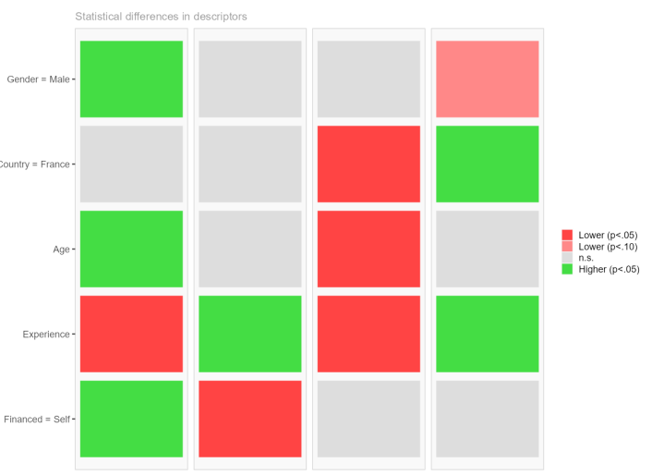
However, the hit rate is only 58%, which means precision is lacking.
It appears that the descriptors used in the study are too vague and not precise enough (or the population too homogeneous in terms of descriptors) to be truly useful with a high success rate.
The entrepreneurs
The thinkers
The sharks
The pivots

Slide 17
More importantly, one has to remember that the segment solution and description are based on ESSEC respondents exclusively, hence suffer significant survival bias:
- Not everyone thinking about doing an Executive MBA applied to the ESSEC program - Not everyone who applied to the ESSEC program decided to join (or was selected) - Not every participant agreed (or had the time) to answer the survey on which the segmentation study is based
Because the survey was designed initially to understand the needs of the participants better, the sample appears appropriate for that purpose. However, if the sales team tries to use the same survey to understand the needs of the entire market, the study will likely suffer from significant biases due to self-selection and survival bias (i.e., not everyone applied, and not everyone was selected into the program).

Slide 18


Marketing
Analytics
MIAD
Maestría
en Inteligencia Analítica de Datos

